Slide 1
1
2
3
1
2
3
4
1
2
3
4
1
2
3
4
1
2
3
4

Slide 2
1
2
3
4
1
2
3
4
1
2
3
1
2
3
4
1
2
3
4

Slide 3
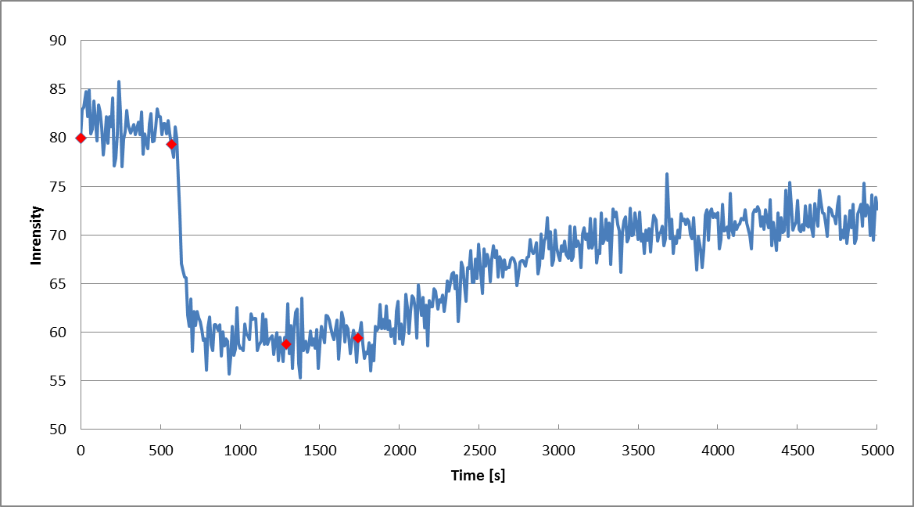
mO
+ mO*
+ I - I*
+ Trigger

Slide 5
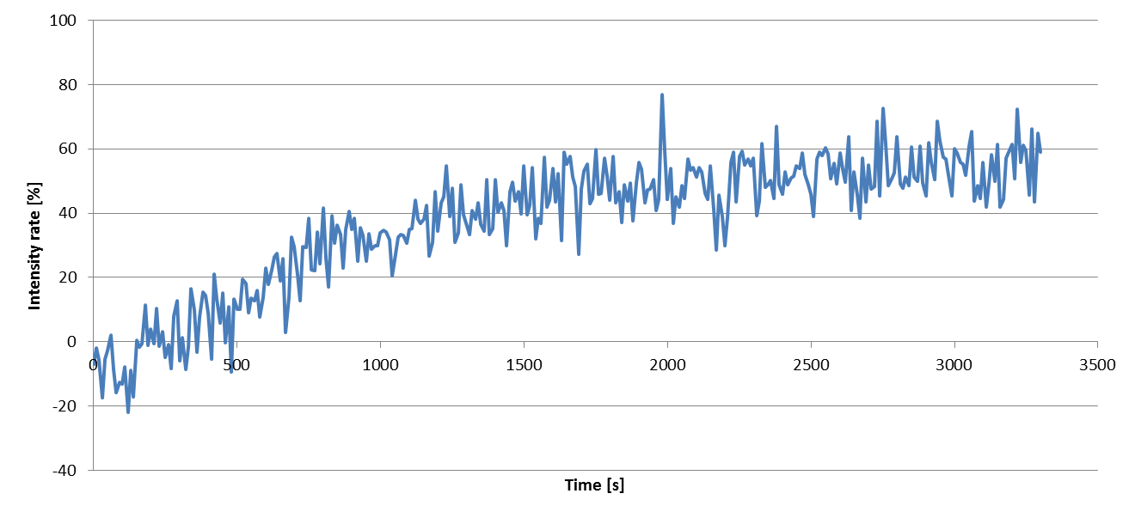

Slide 7
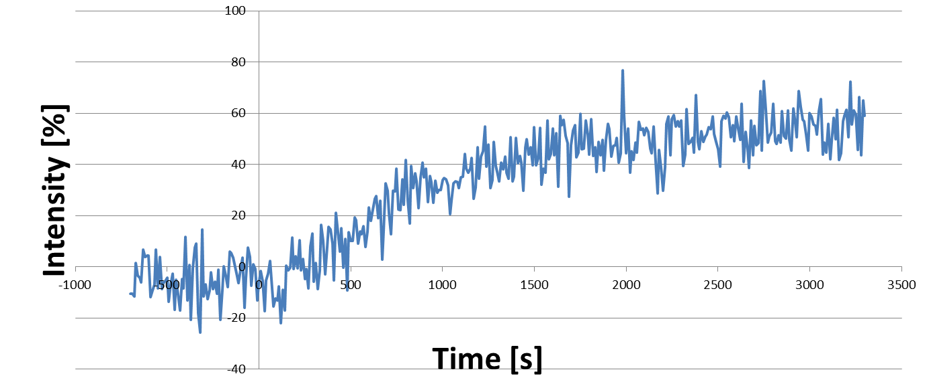

Slide 8
1
2
3
Input & Template complex
Input
Template
Key Strand

Slide 9
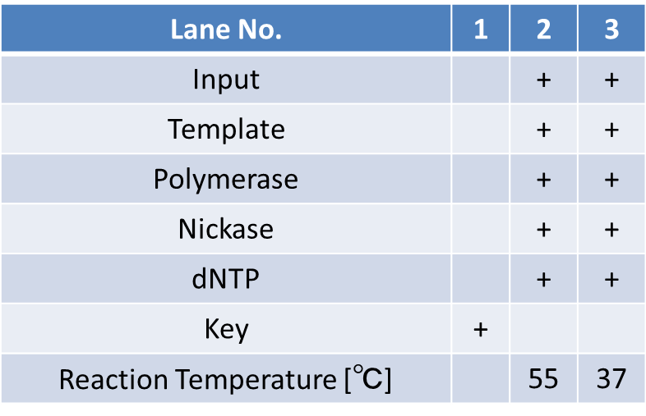
Input & Template complex
Input
Template
Key Strand
Notes:
表はコピーして図として貼り付けた後にグループ化しましょうBy今井

Slide 10
Lane No. | 1 | 2 | 3
Input |  | + | +
Template |  | + | +
Polymerase |  | + | +
Nickase |  | + | +
dNTP |  | + | +
Key | +
Reaction Temperature [℃] |  | 55 | 37
Input & Template complex
Input
Template
Key Strand
Notes:
表はコピーして図として貼り付けた後にグループ化しましょうBy今井

Slide 11
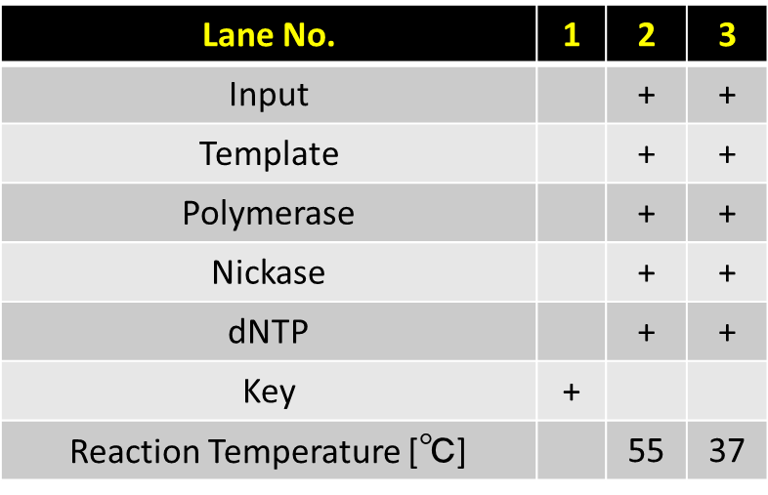
Input & Template complex
Input
Template
Key Strand
Notes:
表はコピーして図として貼り付けた後にグループ化しましょうBy今井

Slide 12
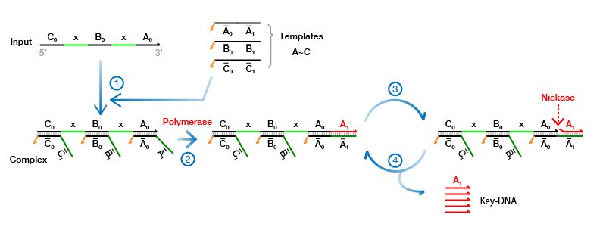

Slide 13
1
2
3
4
Anchor & Output
Waste
Output Strand
Output Strand

Slide 14
1
2
3
4
Anchor & Output
Waste
Output Strand
Output Strand

Slide 15
1
2
3
4
Anchor & Output
Waste
Output Strand
Output Strand

Slide 16
Lane No. | 1 | 2 | 3 | 4
Anchor | + | + | + | +
Output |  | + | + | +
Polymerase |  | + | + | +
dNTP |  | + | + | +
Key |  |  | + | +
Reaction Temperature [℃] |  | 37 | 37 | 65
Anchor & Output
Waste
Output Strand
Output Strand

Slide 17
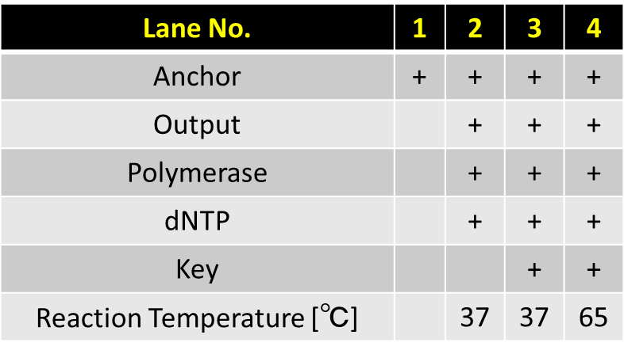
Anchor & Output
Waste
Output Strand
Output Strand

Slide 18
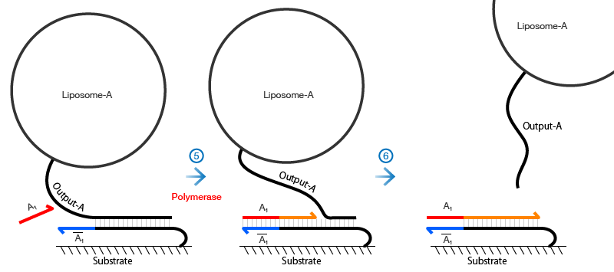
Waste

Slide 19
1
2
3
Gate
Fragment 1
Fragment 1
Fragment 2
Fragment 3

Slide 20
1
2
3
Gate complex
Fragment 1
Fragment 1
Signal
Next Complex
Fragment 2

Slide 21
1
2
3
Gate
Fragment 1
Fragment 1
Signal
Next Complex
Fragment 2 ssdna

Slide 22
Lane No. | 1 | 2 | 3
Input | + | + | +
Gate | + | +
Polymerase | + | +
dNTP | + | +
Key |  | +
Signal |  |  | +
EcoRI | + | + | +
Reaction Temperature [℃] | 45 | 45 | 45
Gate
Fragment 1
Fragment 1
Signal
Next Complex
Fragment 2 ssdna

Slide 23
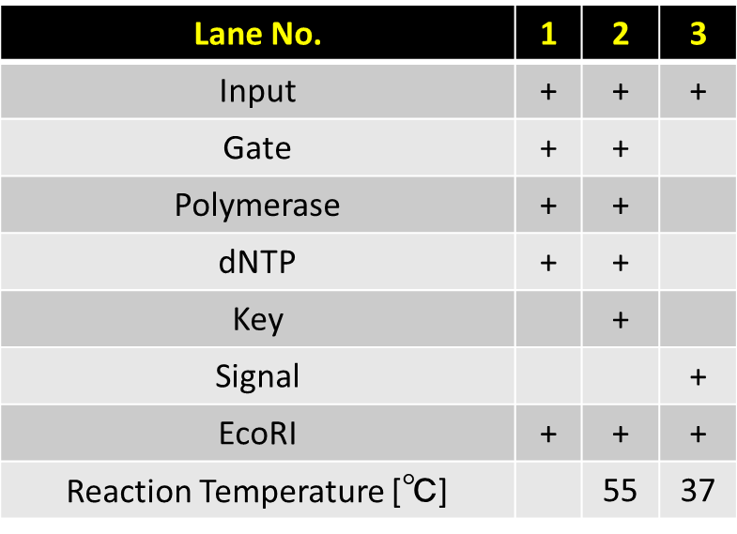
Gate
Fragment 1
Fragment 1
Signal
Next Complex
Fragment 2 ssdna

Slide 24
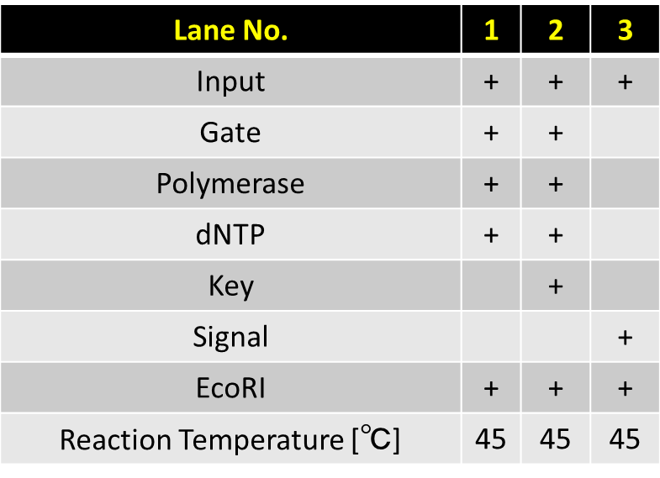
Gate complex
Fragment 1
Fragment 1
Signal
Next Complex
Fragment 2

Slide 25
Lane No. | 1 | 2
Input | + | +
Gate | + | +
Polymerase | + | +
dNTP | + | +
Signal |  | +
EcoRI | + | +
Reaction Temperature [℃] | 45 | 45
Updated Complex
Fragment

Slide 26
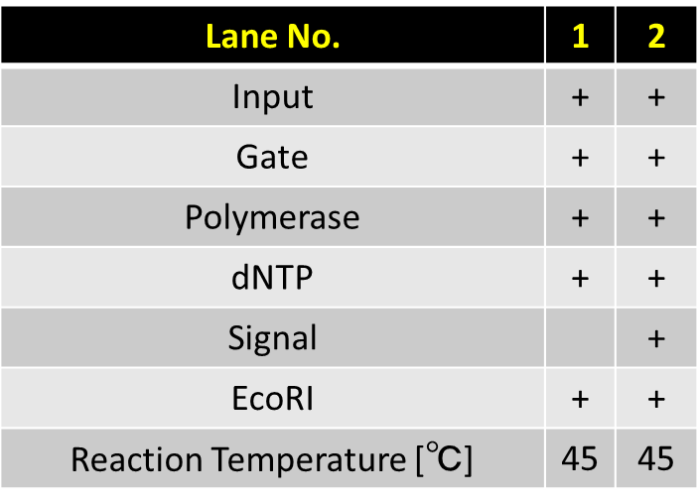
Updated Complex
Fragment

Slide 27
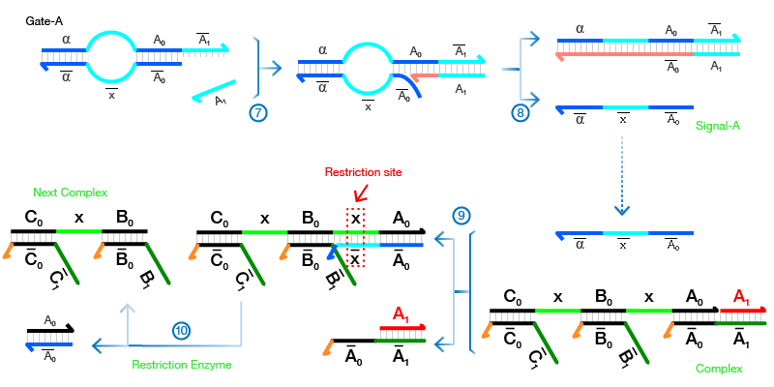

Slide 28
Fluorescence
Stained
1
2
3
4
1
2
3
4
Input &Input*
Output &Output*
Output Strand with FAM
Output with FAM &Output*
Output &Output*
Output Strand

Slide 29
Lane No. | 1 | 2 | 3 | 4
Anchor | + | + | + | +
Output |  | + | + | +
Polymerase |  | + | + | +
dNTP |  | + | + | +
Key |  |  | + | +
Reaction Temperature [℃] |  | 37 | 37 | 65
Lane No. | 1 | 2 | 3 | 4
Anchor | + | + | + | +
Output |  | + | + | +
Polymerase |  | + | + | +
dNTP |  | + | + | +
Key |  |  | + | +
Reaction Temperature [℃] |  | 37 | 37 | 65
Input &Input*
Output &Output*
Output with FAM &Output*
Output Strand with FAM
Output &Output*
Output Strand
Fluorescence
Stained

Slide 30
Lane No. | 1 | 2 | 3 | 4
Input Complex | + | + | + | +
Output Complex |  | + | + | +
Trigger |  | + | +
FAM modified Output |  | + |  | +
Lane No. | 1 | 2 | 3 | 4
Input Complex | + | + | + | +
Output Complex |  | + | + | +
Trigger |  | + | +
FAM modified Output |  | + |  | +
Input &Input*
Output &Output*
Output with FAM &Output*
Output Strand with FAM
Output &Output*
Output Strand
Fluorescence
Stained

Slide 31
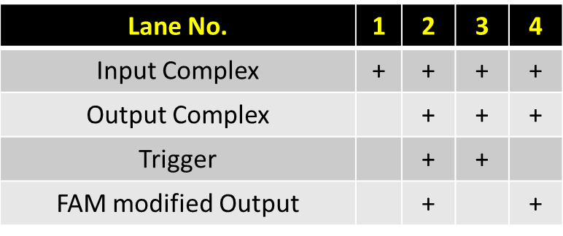
Input &Input*
Output &Output*
Output Strand with FAM
Output with FAM &Output*
Output &Output*
Output Strand
Fluorescence
Stained

Slide 32
Input &Input*
Output &Output*
Output Strand with FAM
Output with FAM &Output*
Output &Output*
Output Strand
Fluorescence
Stained

Slide 33
Lane2
Lane4

Slide 35
Rf Number [-] : 0.790
Band intensity [%] : 9.15 %
Lane 4
Rf Number [-] : 0.663
Band intensity [%] : 90.9 %

Slide 36
Lane 2
Rf Number [-] : 0.788
Band intensity [%] : 92.1 %
Rf Number [-] : 0.663
Band intensity [%] : 7.91 %

Slide 39
Rf Number [-] : 0.662609
Band intensity [%] : 7.908682
Rf Number [-] : 0.662609
Band intensity [%] : 90.85057
Rf Number [-] : 0.787826
Band intensity [%] : 92.091318
Rf Number [-] : 0.789565
Band intensity [%] : 9.149427

Slide 40
Lane 2
Lane 4
Rf Number [-] : 0.662609
Band intensity [%] : 7.908682
Rf Number [-] : 0.662609
Band intensity [%] : 90.85057
Rf Number [-] : 0.787826
Band intensity [%] : 92.091318
Rf Number [-] : 0.789565
Band intensity [%] : 9.149427

